Slide 1
FRAUD DETECTION USING MACHINE LEARNING
GOPAL BHAMMAR
ESET0082

Slide 2

Business Context & Objective
The dataset represents real-world bank transactions between accounts.
Fraudulent transactions are rare but cause significant financial losses.
Objective
Identify patterns and anomalies linked to fraudulent activity.
Create a Power BI dashboard to visualize fraud trends, transaction types, and account behaviors.
Support business teams in proactive fraud monitoring.

Slide 3

Approach / Model Overview
Dataset includes transaction details — type, amount, sender/receiver balances, fraud and other features.
Cleaned and preprocessed data:
Split data into Training (80%) and Validation (20%) sets.
Three models were implemented for comparative analysis:
Logistic Regression :- served as a simple and interpretable baseline.
XGBoost Classifier :- tested for gradient-boosted performance on imbalanced data.
Random Forest Classifier :- evaluated for ensemble-based accuracy and generalization.

Slide 4
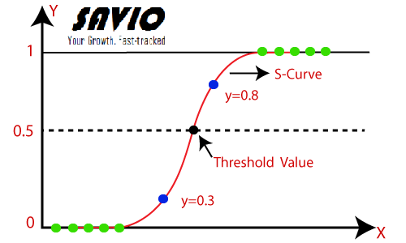
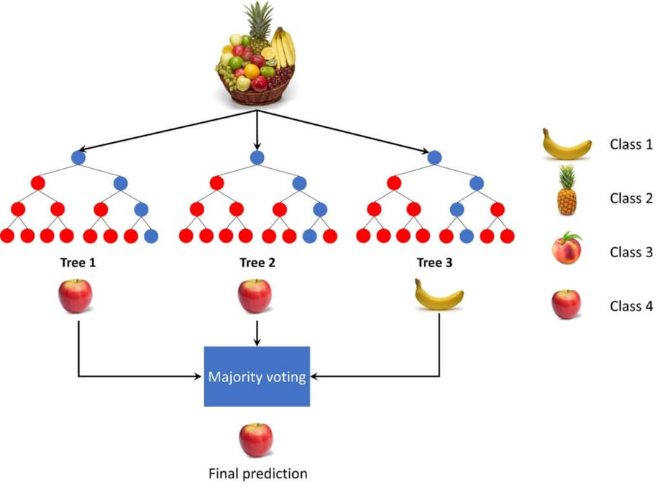
Model Architecture
Source : - Logistic Regression Architecture
Source : - Random Forest Architecture

Slide 5
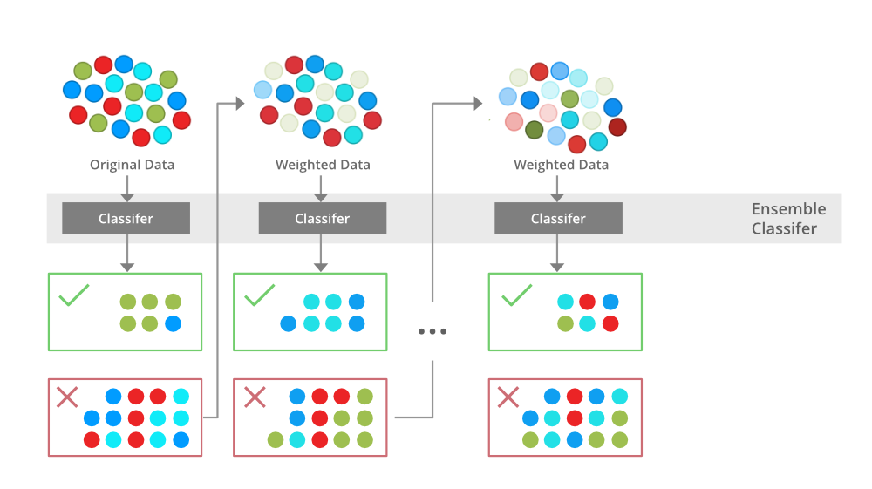
Model Architecture
Source : - XGoost Architecture

Slide 6
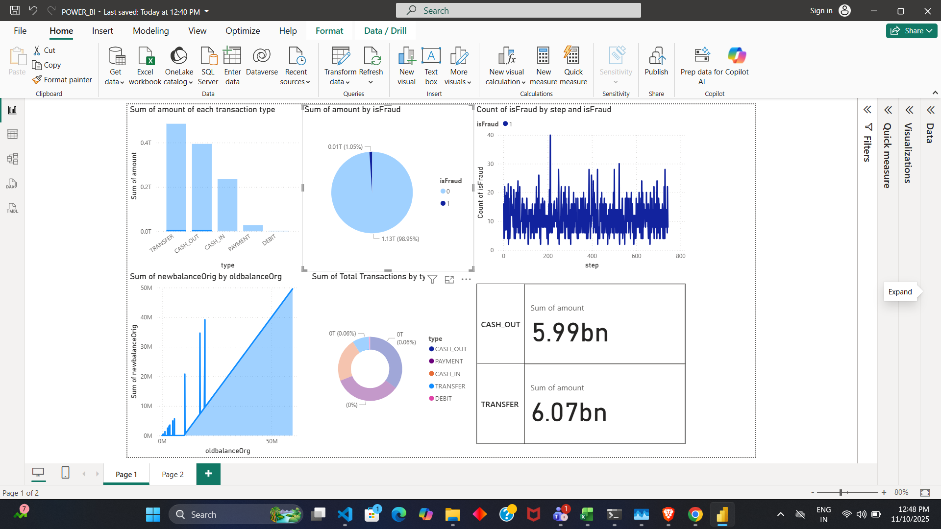
Insights / Results

Slide 7
Insights / Results
01
Model | Training AUC | Validation AUC | Precision | Recall | F1-Score
Logistic Regression | 0.907 | 0.905 | 0.40 | 0.49 | 0.44
XGBoost Classifier | 0.708 | 0.712 | 0.58 | 0.43 | 0.49
Random Forest Classifier | 0.999 | 0.964 | 0.96 | 0.80 | 0.88
04
Actionable Insights
Table 1.1 :- Model Evaluation Results

Slide 8



Business Impact
Enables real-time fraud monitoring through a visual dashboard.
Helps prioritize high-risk transaction types and account behaviors.
Reduces financial loss by early detection of suspicious patterns.
Provides data-backed evidence for investigation teams.
Can integrate with machine learning models to automate fraud flagging.

Slide 9
Recommendations / Next Steps
Short-Term Actions :
Deploy the Power BI dashboard for live transaction monitoring.
Automate data refresh from transaction systems.
Set up alerts for high fraud-rate thresholds.
Long-Term Improvements :
Integrate machine learning model outputs (probability of fraud) into dashboard.
Use real-time streaming data from payment gateways.
Expand dataset with geolocation, device ID, and user behavior features.

Slide 10
Thank You

